Slide 1

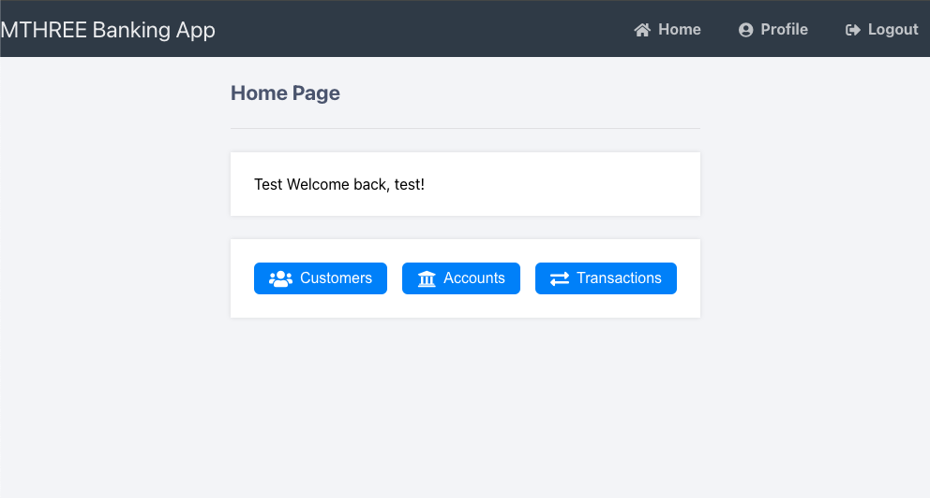


MThree Banking App
Problem Statement:
Time consuming management of bank accounts
Solution
User-friendly API driven platform that streamlines the management of banking operations for bank staff.

Slide 2
Outline
Project planning
Allocation of tasks
Demonstration
System Architecture
Future improvements

Slide 3
Project planning
Agree user stories
Minimum viable product
API and database integration
Ability to create, read, update and delete database entries for customers, accounts and transactions via manually constructed HTTP requests
Stretch goals
Front end
Containerisation
User registration and login
User sessions
Version control and project management
Git and GitHub
Agree SOP’s
GitHub Projects: ticketing & task allocation
Sprint planning
Sprint 1: Build the database. Build API routes for CRUD operations on customers, accounts and transactions
Sprint 2: Implement front end templates. Adjust API routes to deliver templates
Sprint 3: Finalising, bug fixing and containerisation

Slide 4
Task Allocation
Jack Dench
David Olima
Database Creation
Creation of Database Connector
Database Seed Script
Customer GET/POST/DELETE
API endpoint re-factoring
Containerisation
Account GET/POST/MODIFY
Transactions GET/POST/MODIFY
Front end templates HTML
CSS modifications
User login functionality
Sprint Planning
Git repository maintenance
Testing
Trouble shooting

Slide 5
Demonstration

Slide 6
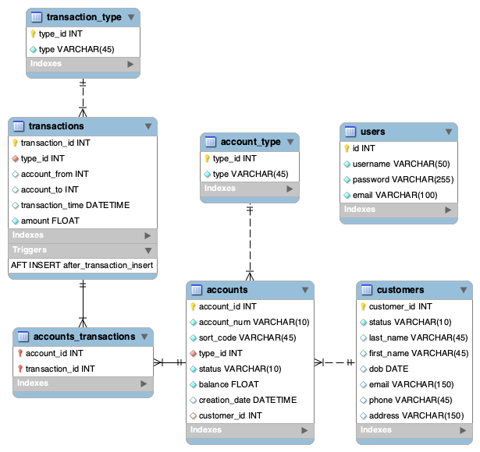
System architecture
Back End
Python Flask API
MySQL relational database
Trigger automation
Database setup and seed scripts
Reusable database connection python script

Slide 7
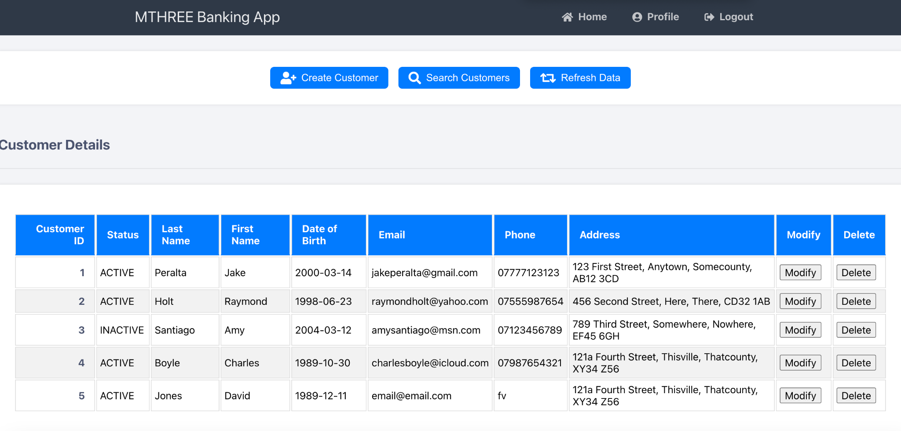
System architecture
Front End
FLASK in-built template capability
Creation of HTML templates for EPs
Incorporating Style sheets for pages
Standardising table formatting
JS for user friendly interaction
Testing user flow through app

Slide 8
System architecture
Containerisation
Docker
Multiple containers
Automated database creation and setup

Slide 9
Future Enhancements
TLS implementation
Key pair authentication and HTTPS
Mobile App integration
Multiple user types & permissions
Customer Frontend
User profile editing
Online Hosting of database & server. Automated CI/CD pipeline and cluster management
Logs & Analytics
Improved error handling

Slide 10
THE END

